Slide 1

Advanced programming practice project
TEAM MEMBERS:
Yuv Raj Singh Thakur
Laksh Nagori
Akshat Singh
Asif Hammad

Slide 2

Title of the project
Chess game system
Project Overview:
Developed a fully functional chess game platform supporting both Player vs Player and Player vs Computer modes.
Integrated multiple AI difficulty levels to cater to players of varying skill.
Designed an intuitive, colorful graphical user interface (GUI) for easy interaction and enhanced user experience.
Implemented robust move validation adhering strictly to official chess rules.
Developed intelligent AI decision-making algorithms for challenging gameplay.
Utilized object-oriented programming in Java, modeling each chess piece as a distinct class with inheritance and polymorphism.
Ensured clean code architecture for scalability and easy maintenance.
Demonstrated comprehensive management of game logic including turn-based play, check, and checkmate detection.
This project showcases strong programming skills, game development knowledge, and application of algorithmic logic in a classic board game setting.

Slide 3
Abstract
The Chess Game System is designed to provide an interactive platform for playing chess. It supports Player vs Player and Player vs Computer modes with AI-based difficulty levels. The system features a colorful GUI, move validation, and intelligent AI decision-making.
This project presents a fully functional chess game developed using Java, emphasizing object-oriented design and algorithmic logic.
The implementation leverages Java's class-based architecture to model the board, pieces, and game rules. Each chess piece (Pawn, Rook, Knight, Bishop, Queen, King) is represented as a distinct class inheriting from a common superclass, enabling polymorphic behavior and clean code organization.

Slide 4
Key features include:
🧠 Turn-based logic with alternating player control
✅ Move validation using rule-based algorithms
👑 Check and checkmate detection
🎨 Graphical User Interface (GUI) using Java Swing (optional)
🗃️ Modular code structure for scalability and readability
This project not only demonstrates proficiency in Java programming but also showcases problem-solving skills in game logic, data structures, and user interaction. It serves as a foundation for further enhancements such as AI opponents, multiplayer support, and online integration.

Slide 5
Problem Statement & Motivation
Manual chess requires physical presence and lacks digital features such as undo, replay, or AI opponents.
Players face challenges practicing alone without competitive opponents.
This project aims to develop a Java-based chess game that faithfully replicates the rules and mechanics of classical chess while emphasizing clean object-oriented design, modular architecture, and user-friendly interaction.
The motivation behind this project stems from a desire to combine strategic gameplay with technical learning. Chess is not only a timeless game of intellect but also a powerful tool for teaching programming concepts such as:
Inheritance and polymorphism through piece behavior
Data structures like arrays and lists for board representation
GUI development using Java Swing for interactive play
By building this game from scratch, the developer gains hands-on experience in Java programming, problem-solving, and software design. It also serves as a stepping stone toward more advanced topics like artificial intelligence.

Slide 6
System Requirements
Functional Requirements:
Player vs Player mode
Player vs Computer mode (Easy, Medium, Hard AI)
Move validation and path checking
Check, Checkmate, Stalemate detection
Restart and Undo options
Colorful GUI with highlights
Save/Load and Replay (future)
Non-Functional Requirements:
Cross-platform support
User-friendly GUI
Efficient AI performance
Scalability for multiplayer
Data persistence for saved games
System stability and error handling

Slide 7
Technical Requirements
Programming Language: Java (JDK 1.8+)
IDE: Eclipse, IntelliJ IDEA, or NetBeans
GUI Framework: Java Swing / JavaFX
AI Algorithms: Minimax with Alpha-Beta Pruning
Database: MySQL/SQLite (for multiplayer)
OS: Windows / Linux / macOS

Slide 8
Use Case Diagram (Description)
Actors:
• Player – Starts games, chooses difficulty, plays moves
• Computer AI – Responds with optimal moves
• System – Validates moves, updates GUI, manages state
Primary Use Cases:
• Start Game
• Select Mode
• Make Move
• Validate Move
• AI Decision
• Declare Winner
• Restart Game

Slide 9
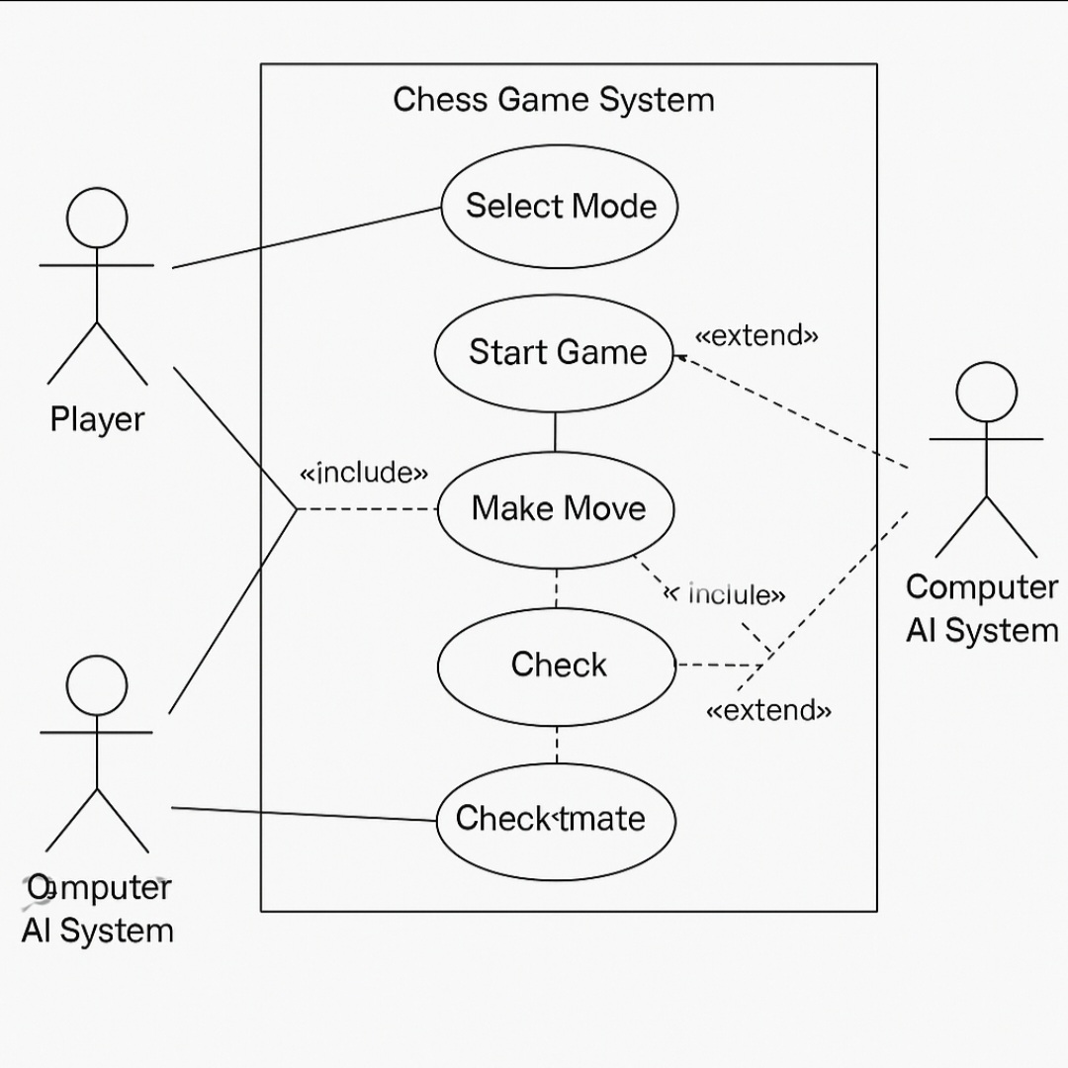
USE CASE DIAGRAM

Slide 10
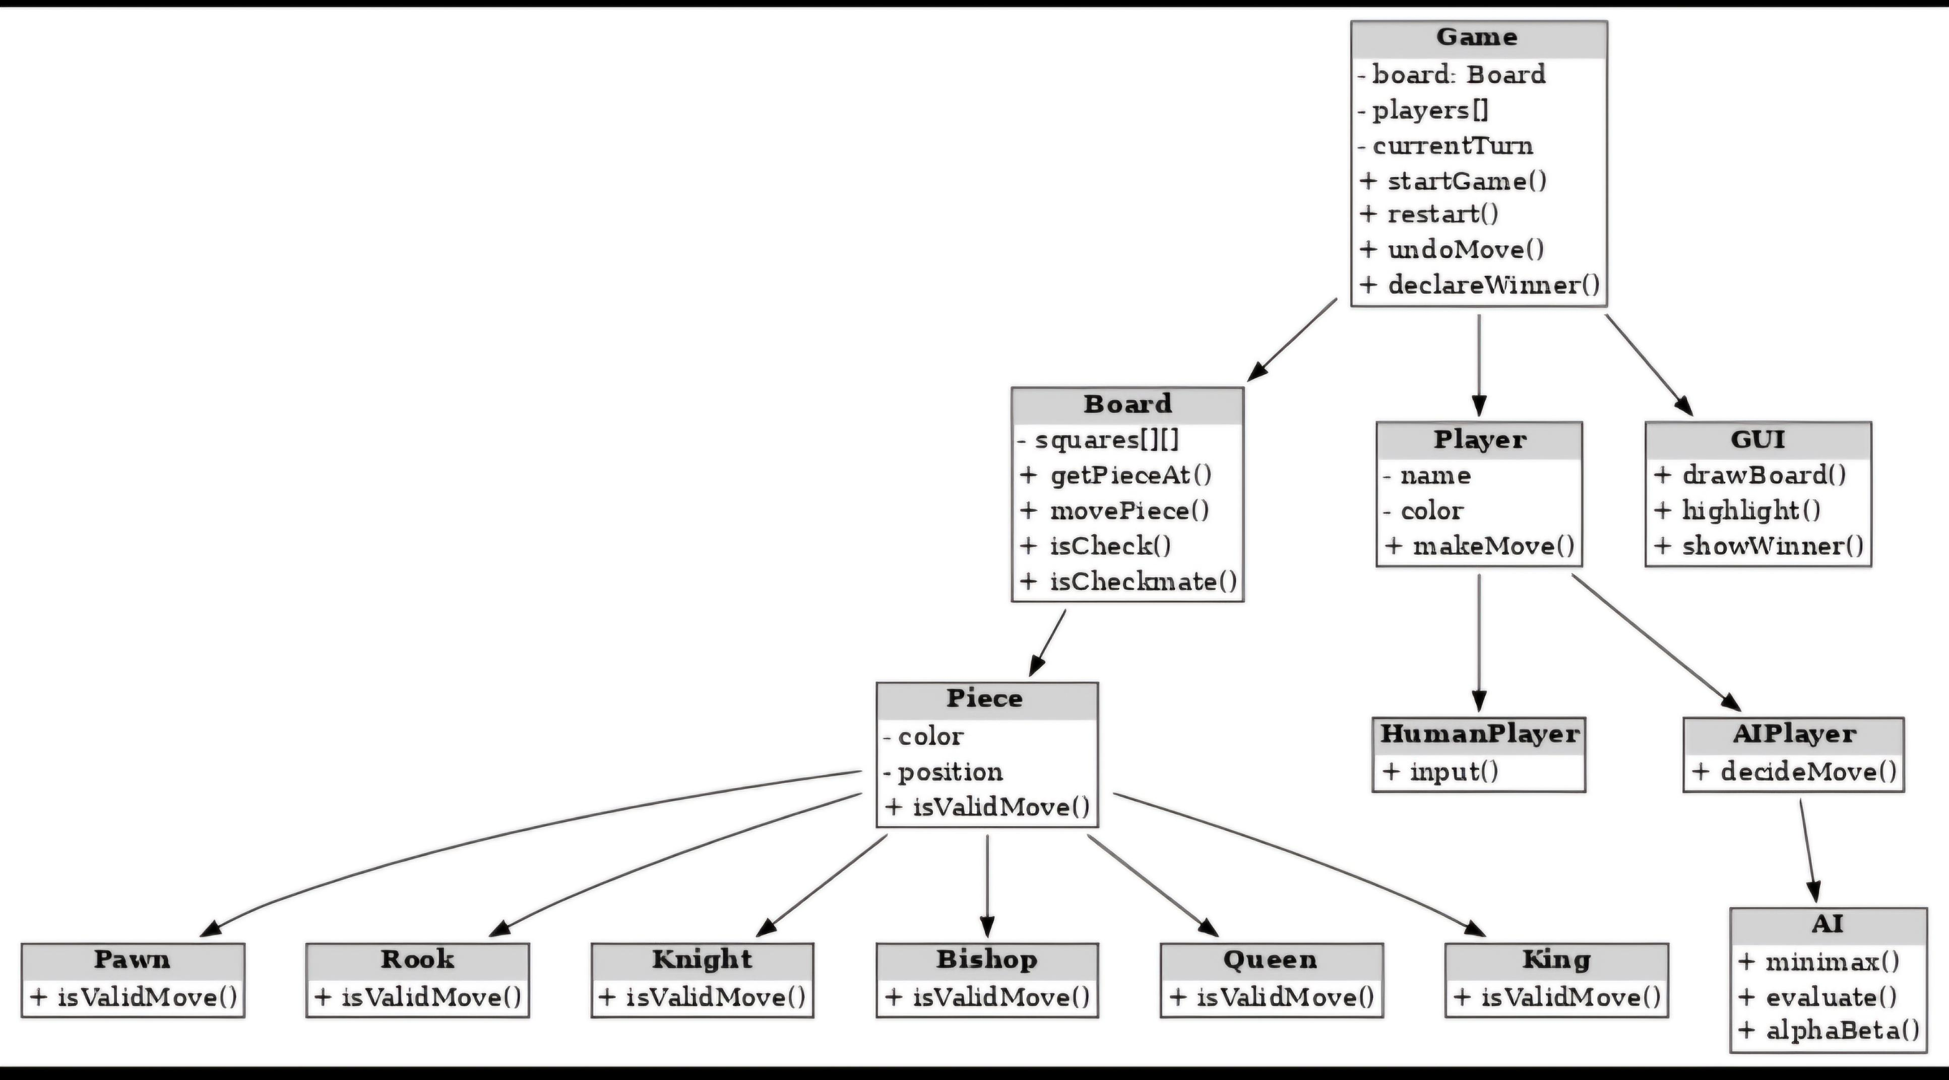
CLASS DIAGRAM

Slide 11
Module Breakdown
Authentication Module (optional)
Game Engine Module – Move validation, checkmate detection
AI Module – Minimax + Alpha-Beta pruning
GUI Module – Interactive chessboard, highlights
Game Management Module – Restart, Undo, Save/Load
Reporting Module – Match history and replay (future)

Slide 12
System Architecture & Timeline
Three-Tier Architecture:
1. Presentation Layer – GUI (Swing/JavaFX)
2. Business Logic Layer – Game engine & AI
3. Data Layer – Database for multiplayer/saved games
Implementation Timeline:
• Week 1-2: Setup project, GUI design
• Week 3-4: Move validation
• Week 5-6: PvP gameplay
• Week 7-8: AI with difficulty levels
• Week 9-10: Restart/Undo, testing
• Week 11-12: Save/Load, multiplayer

Slide 13
Outcomes & Enhancements
Expected Outcomes:
• Interactive chess gameplay
• AI with multiple difficulty levels
• Enhanced user experience with GUI
Future Enhancements:
• Online multiplayer
• Mobile app version
• Integration with Stockfish
• Training mode with hints
• Machine learning AI
.

Slide 14
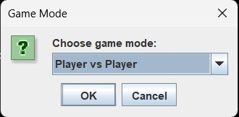
GUI Implementation

Slide 15
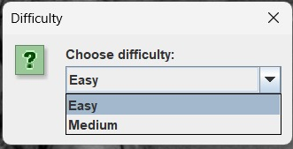

Slide 16
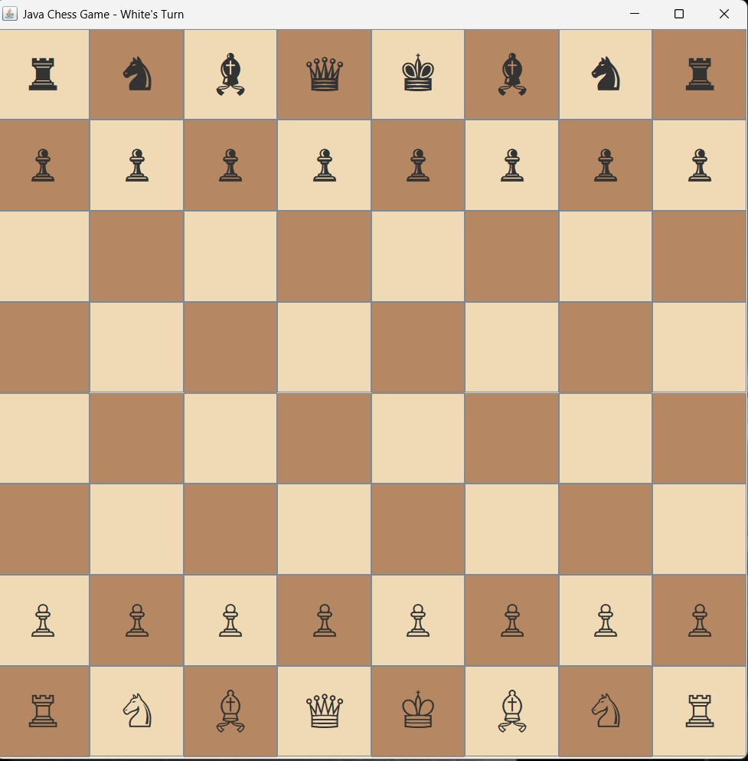

Slide 17
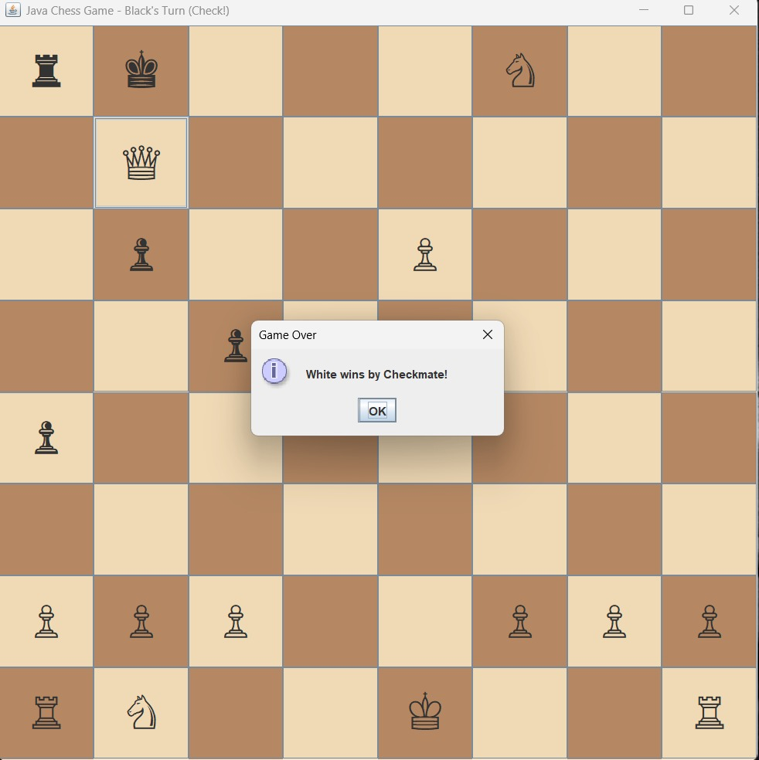

Slide 18
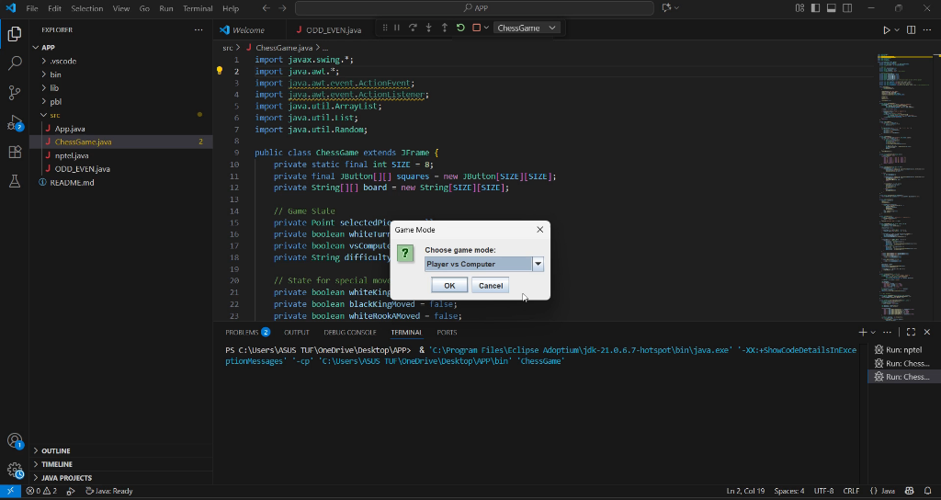
SMALL VIDEO ON GUI DEMONSTRATION

Slide 19
CONCLUSION
This project aims to develop a Java-based chess game that faithfully replicates the rules and mechanics of classical chess while emphasizing clean object-oriented design, modular architecture, and user-friendly interaction.
The development of a chess game in Java successfully demonstrates the integration of object-oriented programming principles with strategic game logic. By modeling each chess piece as a class and implementing rule-based movement, the project showcases how complex systems can be built using modular and maintainable code.

